Slide 1
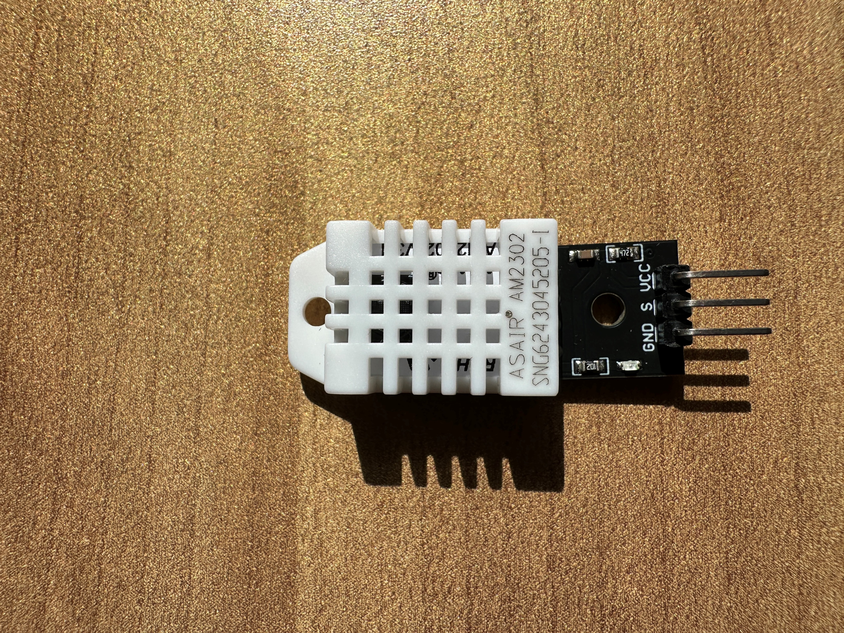

GND
VCC
DATA
Pin: 6
(Ground)
Pin: 7
(GPIO 4)
Pin: 17
(VCC 3.3V)

